Slide 1
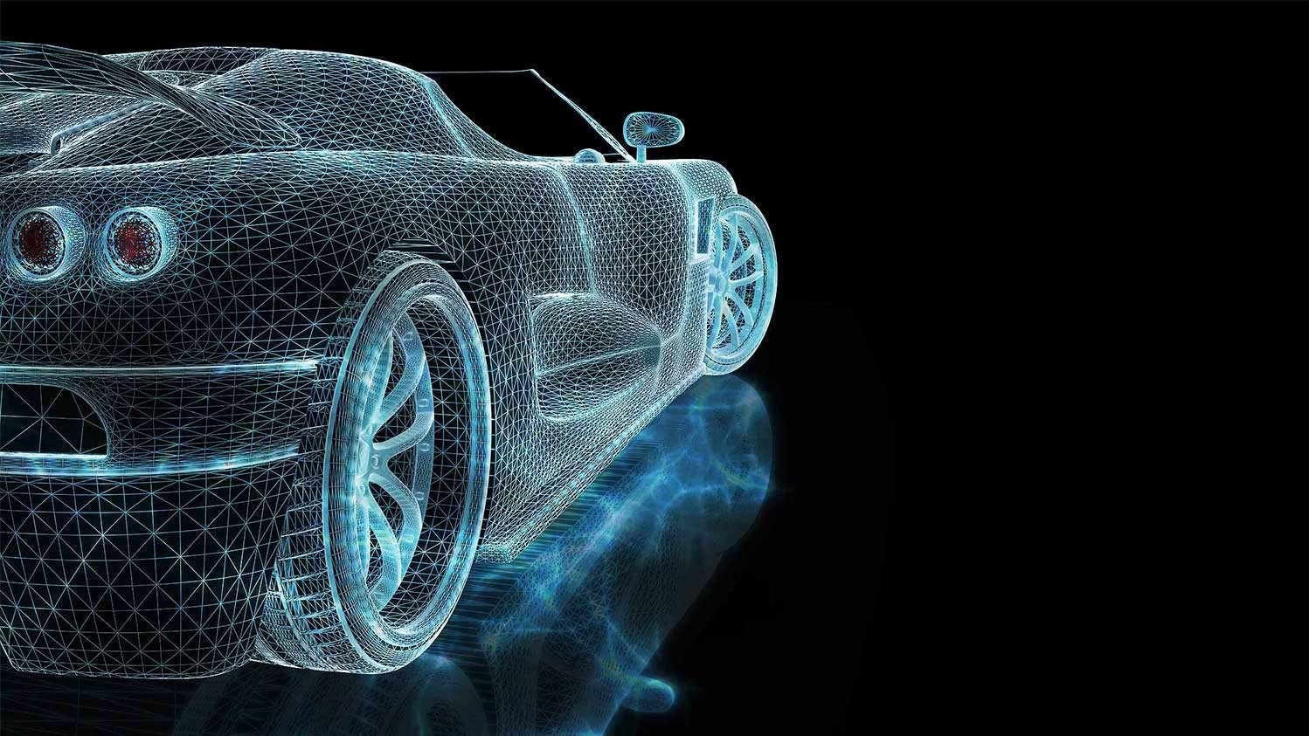

IoT-BASED EV SMART PARKING AND GREEN CHARGING SYSTEM
Project Members:
Kushal Singh
Anmol Maddeshiya
Siddharth Singh
Satyam Kumar
Guide Name :
Mr. Nishant Anand

Slide 2

Problem Statement :
Urban living needs centralized public facilities.
Almost no car parking facilities in operation today can handle the flood of vehicles.
It takes time to look for a vacant parking space.
It causes increased traffic congestion since many vehicles may compete for limited parking spaces.
After that there is also a problem with EV charging points across the city.
EV charging points are yet to upgrade to a renewable source of energy.

Slide 3
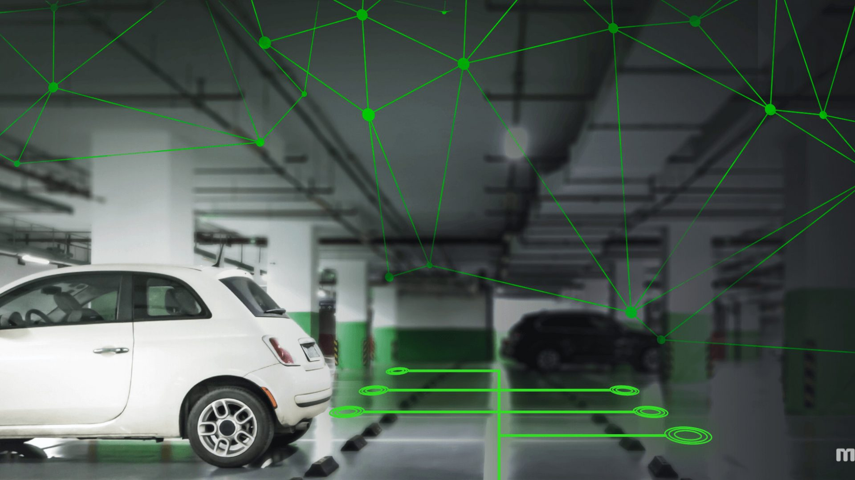
Proposed Solution :
To provide information about slot availability for parking using IoT App/Browser.
To provide wired charging of Electric Vehicle .
To provide green charging using solar panels.

Slide 4

Hardware components :
Node MCU/ Wi-Fi ESP-32
Arduino UNO
Power hub
6 IR Sensors
Servomotor
16x2 LCD Display
Solar Panel(15V)
Programming cables
LM35 Temperature Sensor
Diode, LED, Capacitor
Battery(12V)
Regulator 7805

Slide 5

Software Used :
Arduino IDE 1.8.15
Internet of Things (IoT) App.

Slide 6

Flow diagram:

Slide 7

Conclusion :
Optimised Parking
Reduced Traffic and Reduced Pollution
Green charging system
New Revenue Options
Fast Payments
Decreased Management Costs
Real-Time Data and Trend Insight

Slide 8

THANK YOU

